Slide 1

AASD 4016
Full Stack Data Science Systems
Applied AI Solutions Developer Program

Slide 2
Module 5
Deployment
Vejey Gandyer

Slide 3
Agenda
Deployment
Dockerhub
Creating GCP account
GCP instance
SSH
Installing Docker
Running the docker container
Testing the public endpoints

Slide 4
Iris Classifier
Push the docker image into Dockerhub
Create GCP Compute Engine
SSH into GCP instance
Install docker
Pull the docker image from Dockerhub
Run the docker container
Test the public endpoints
Notebook to Script
Script to Flask
Load model and keep it up for inference
Infer from the model
Test the endpoint using Curl, POSTMAN
Build a python web client
Test the client
Create a Virtual Environment
Install all libraries
Create requirements.txt
Create a Dockerfile
Create a Docker image
Create a Docker container
Test the endpoints within the running Docker container

Slide 5
Current Flask project structure
Project Structure
app.py
helper(s).py [Optional]
templates/
index.html
result.html
static/
Style.css [Optional]
Dockerfile
requirements.txt
iris-venv/
.dockerignore

Slide 6
Deploying a web application
Installing Docker
Creating a Virtual environment
Installing necessary libraries
Creating requirements.txt
Creating a Dockerfile
Building a Docker image
Running a Docker container
Testing the endpoints
Push docker image into Dockerhub
Creating GCP instance
SSH into instance
Install docker
Pulling a Docker image​
Running a Docker container​
Testing the public endpoints​

Slide 7
Dockerhub

Slide 8
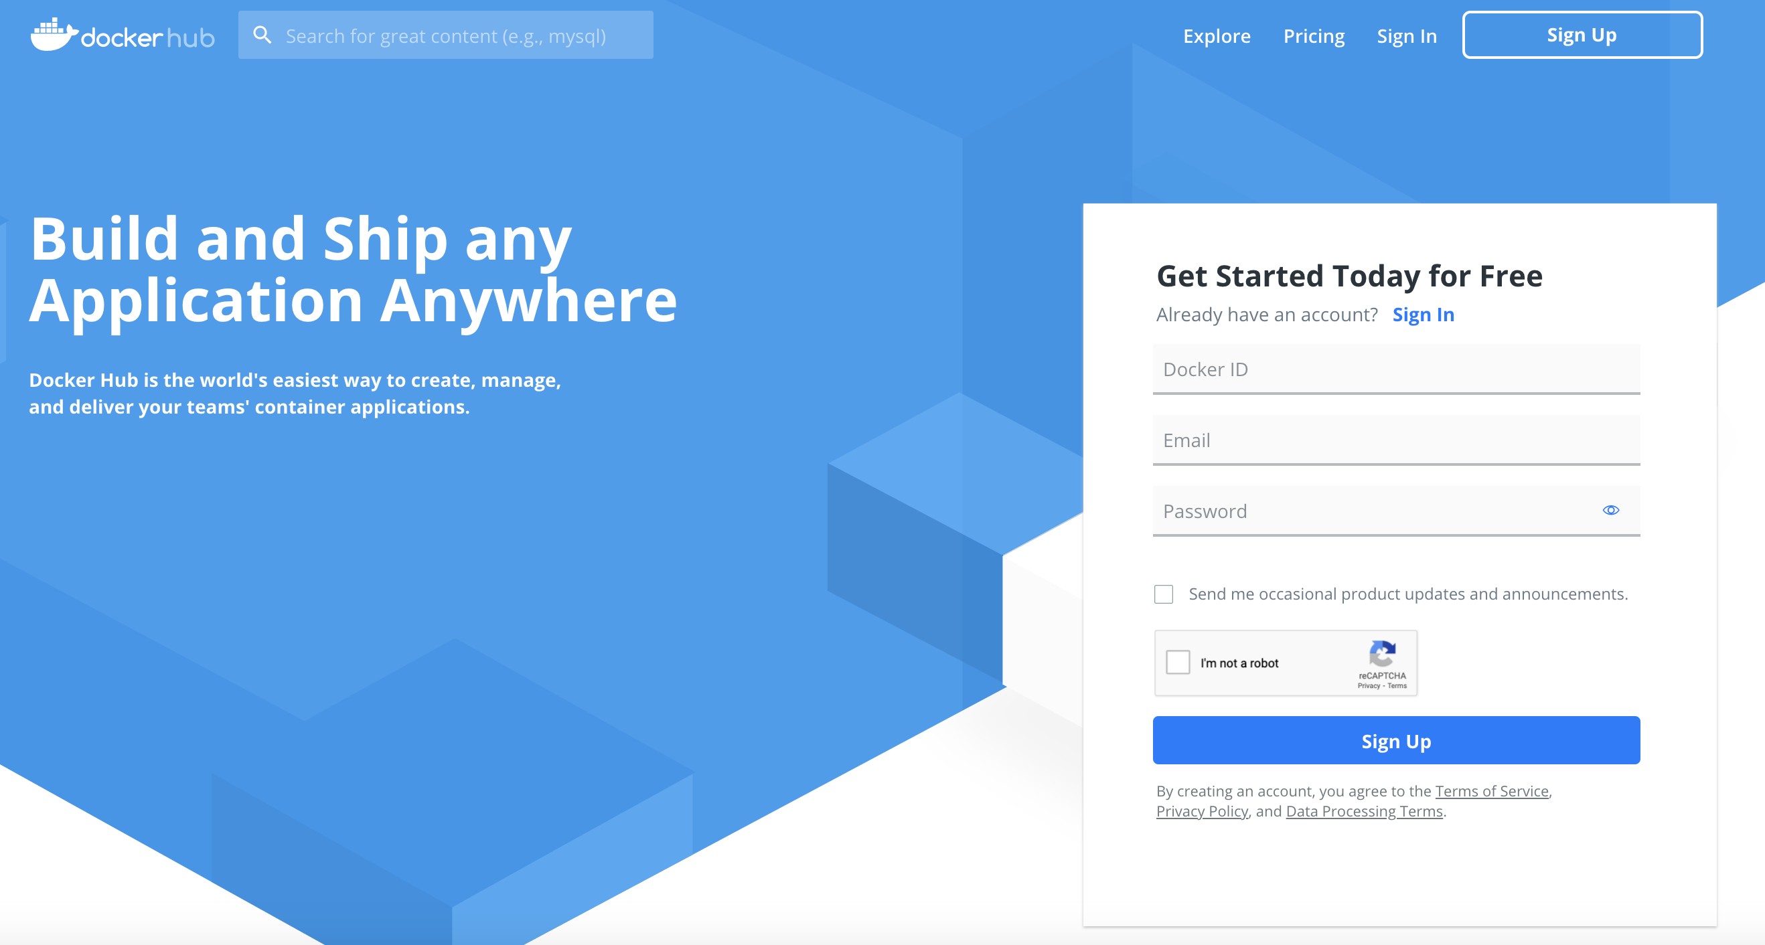
Dockerhub
Create a Dockerhub account
https://dockerhub.com

Slide 9
Connect to the Dockerhub
Create a Dockerhub account
docker login
Username: Username
Password: Password

Slide 10
Push to the Dockerhub
Tag the docker image with Dockerhub
docker tag iris:3.0 subashgandyer/iris:3.0
Push the tagged docker image
docker push subashgandyer/iris:3.0

Slide 11
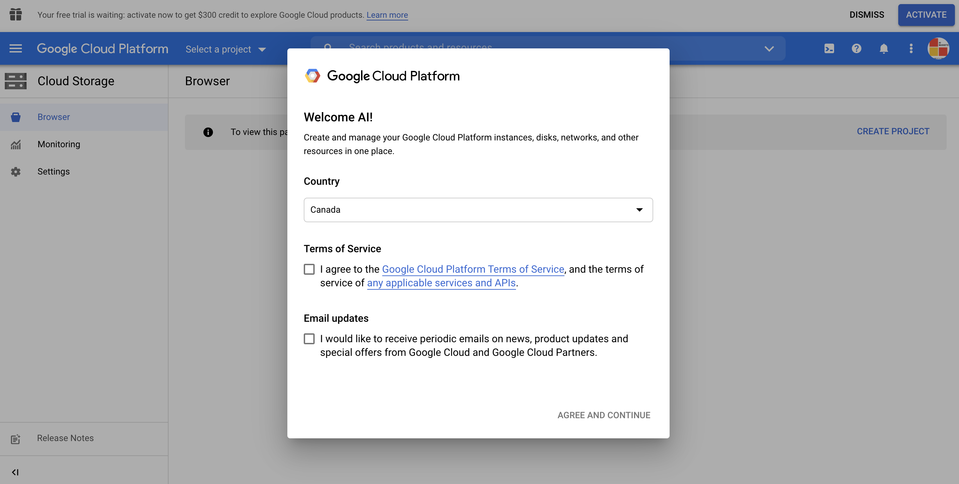
Google Cloud Platform
Create a new account console.google.com

Slide 12
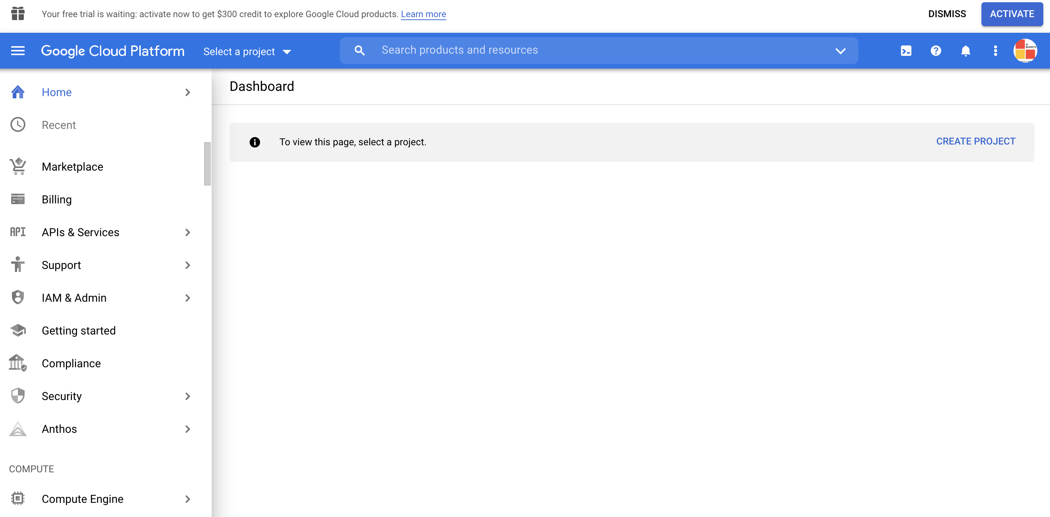
Google Cloud Platform
Dashboard

Slide 13
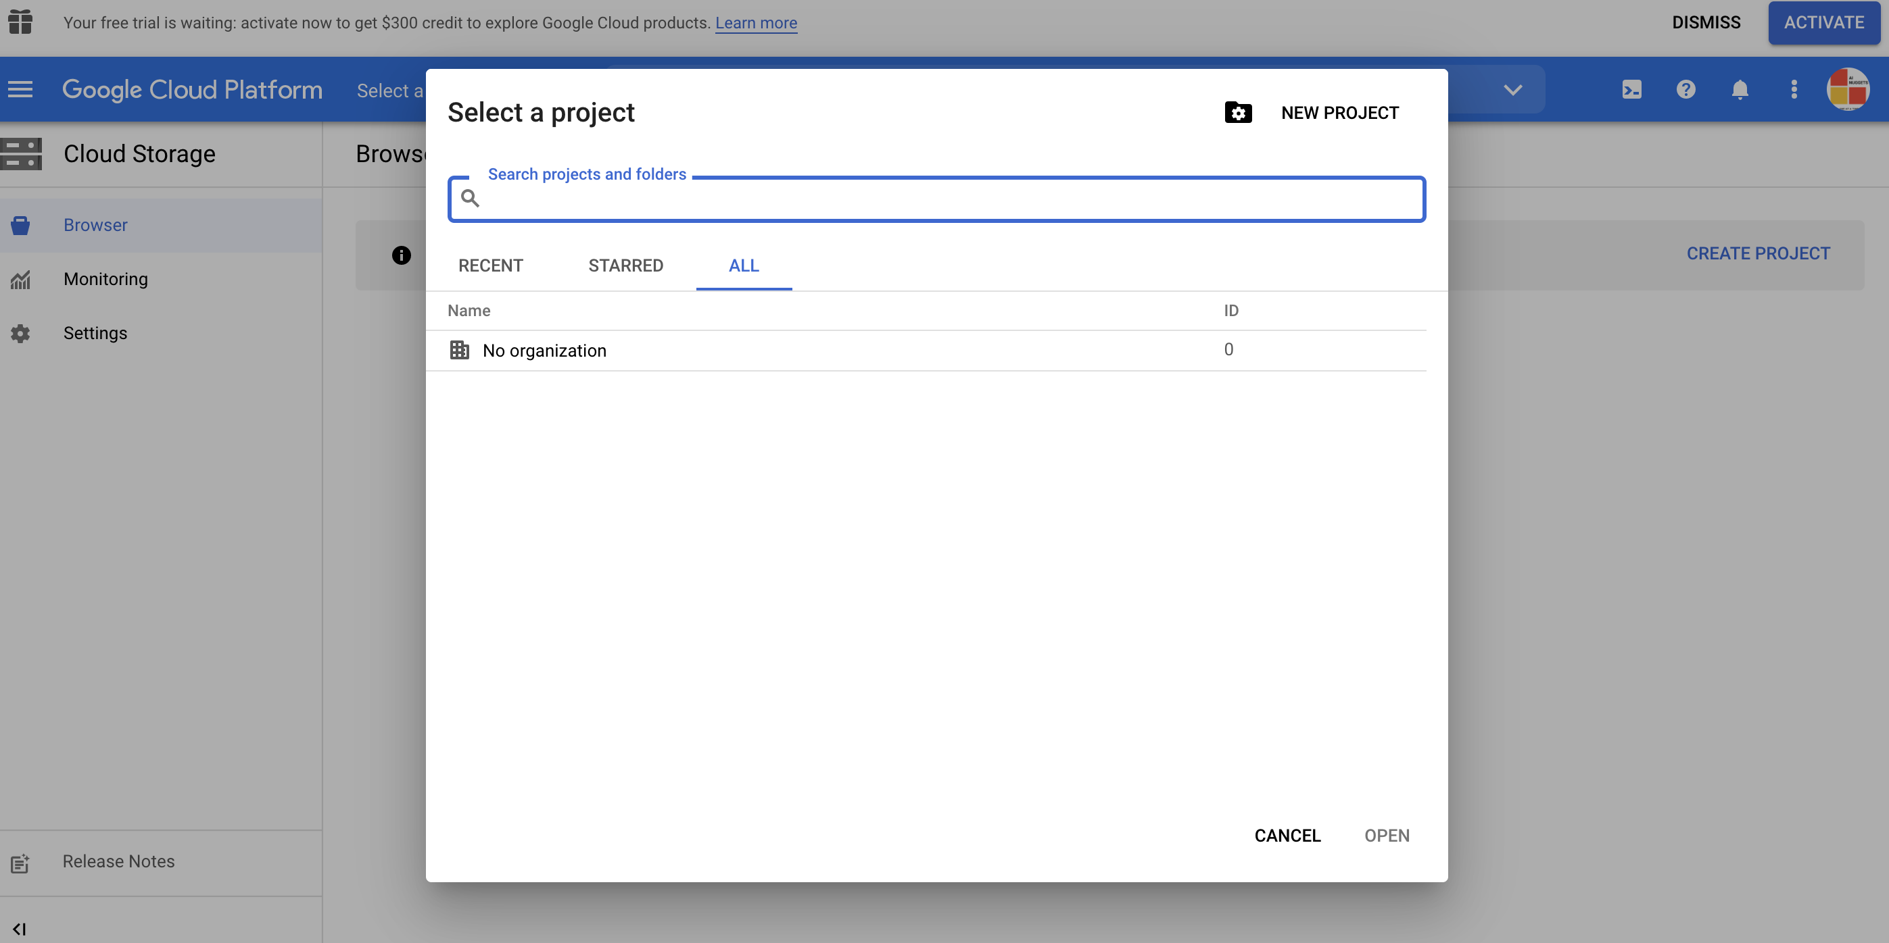
Google Cloud Platform
Create a new project

Slide 14
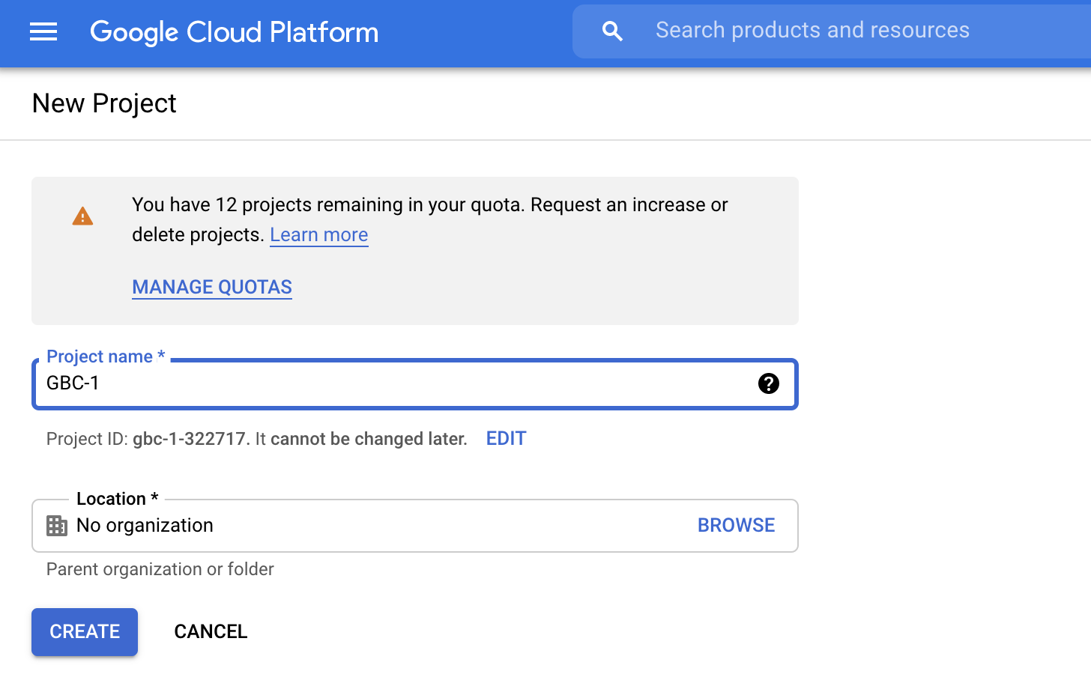
Create a new project

Slide 15
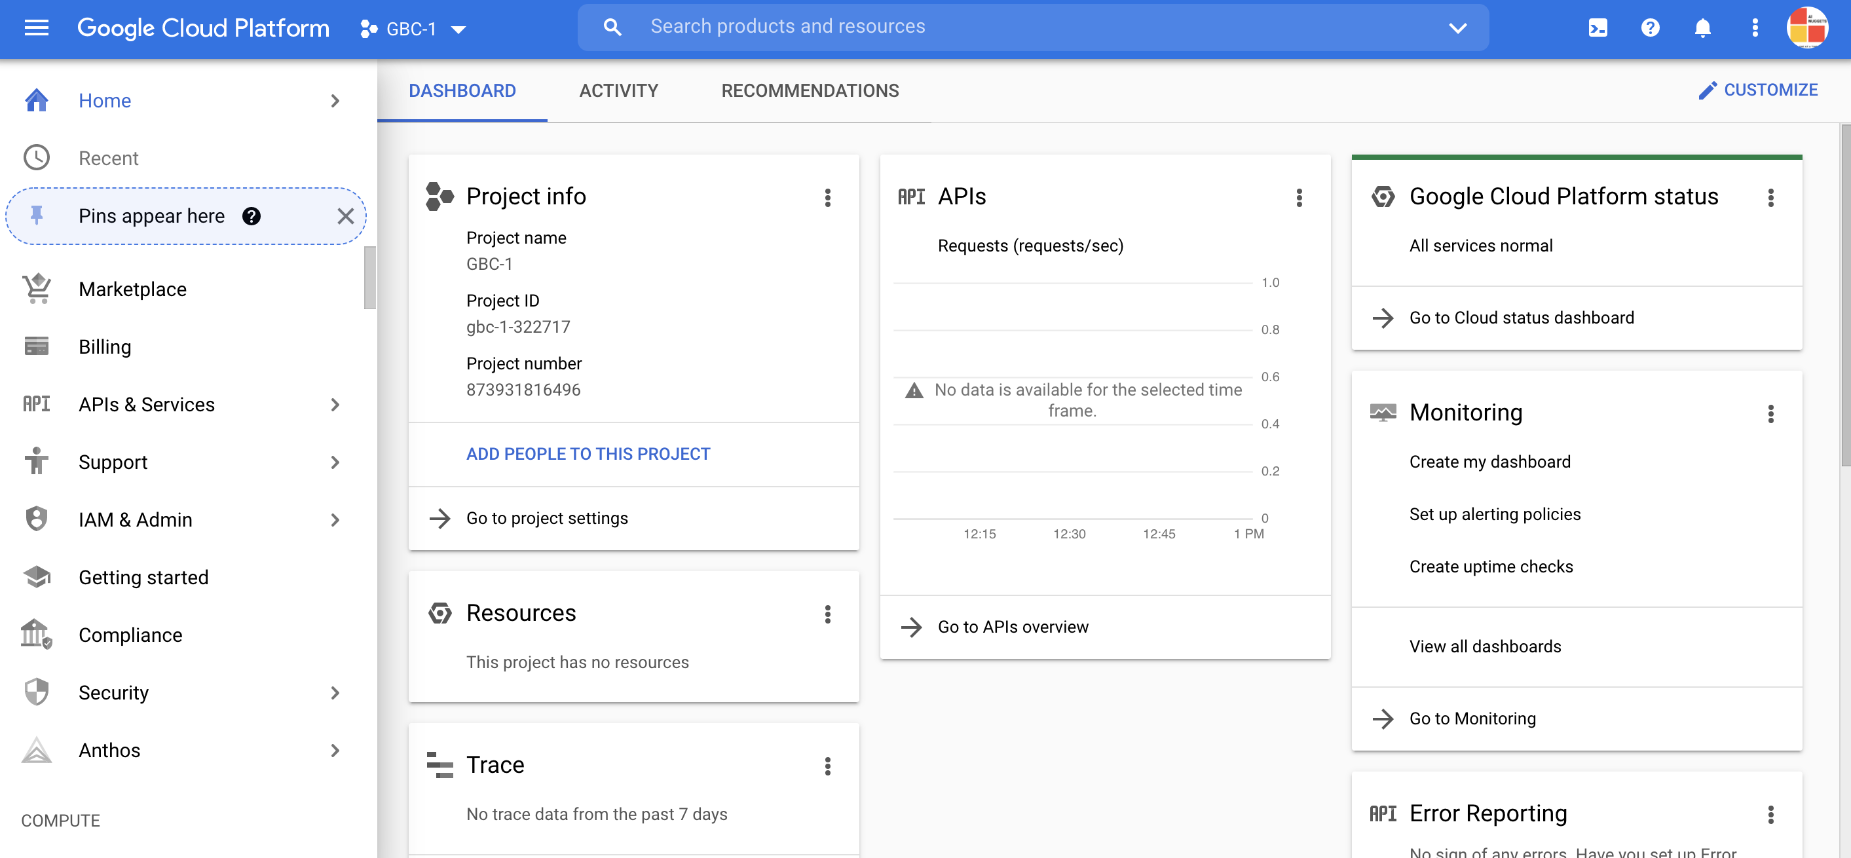
New Project
Dashboard

Slide 16
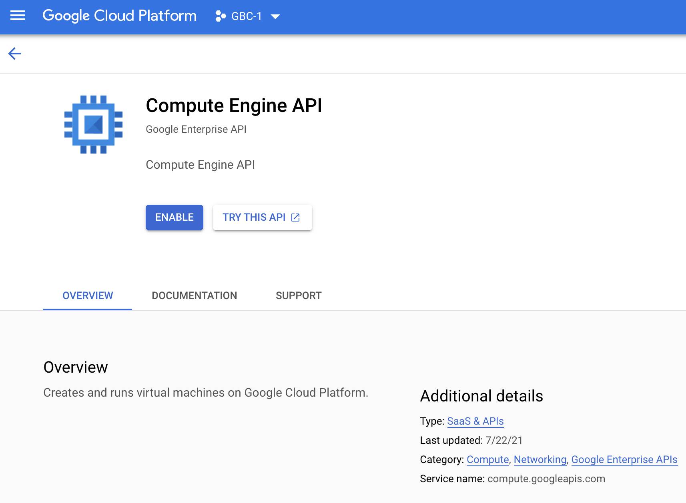
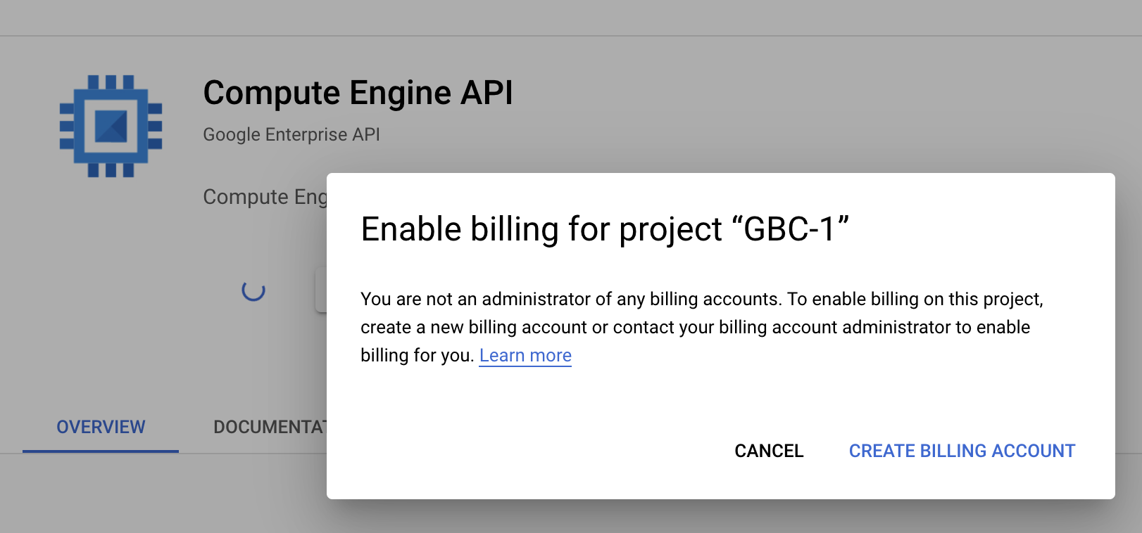
Enable Compute Engine API

Slide 17
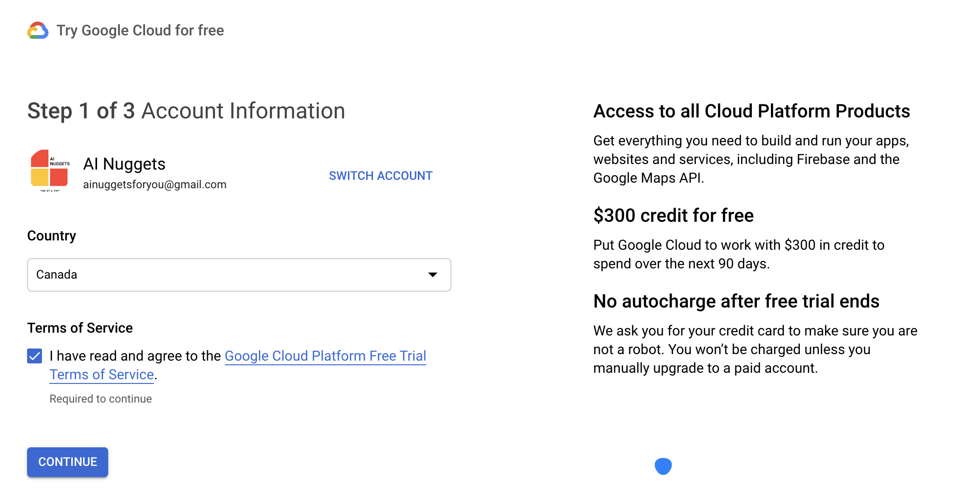
Billing Info for Credit Card

Slide 18
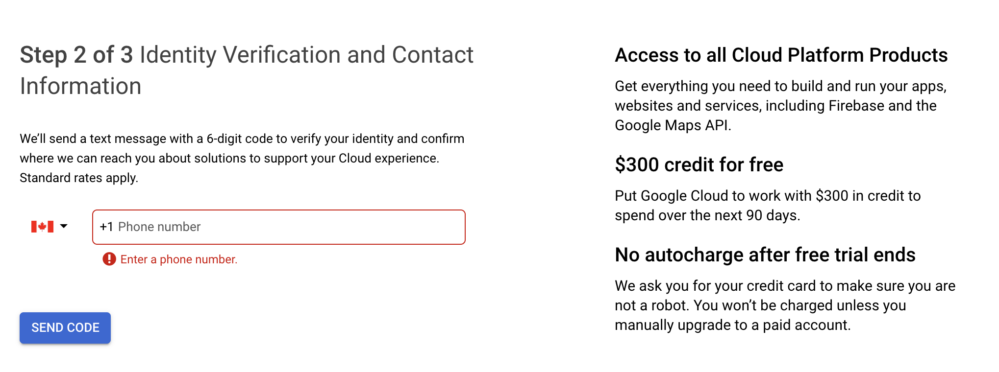
Billing Info for Credit Card

Slide 19
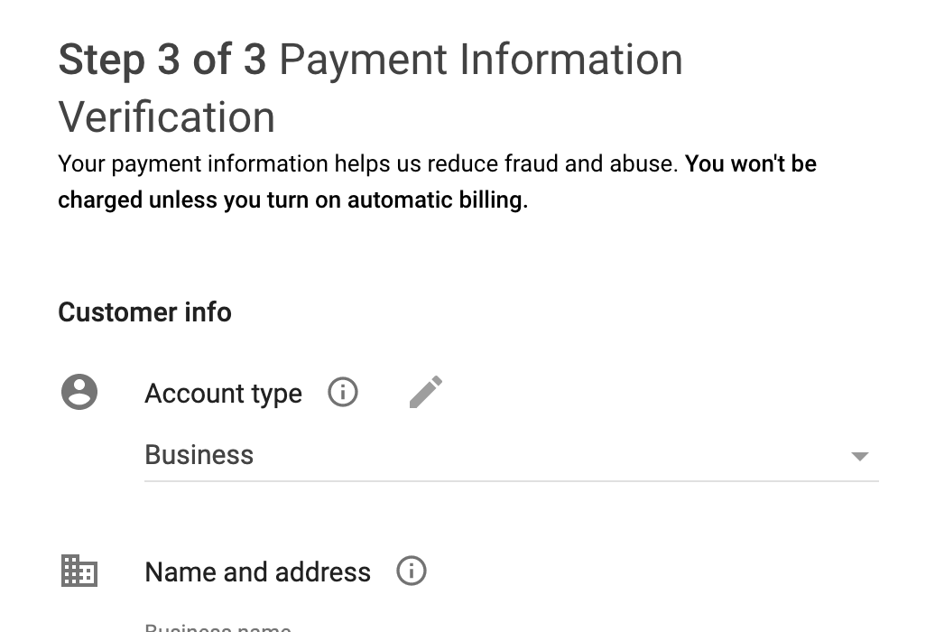
Billing Info for Credit Card

Slide 20
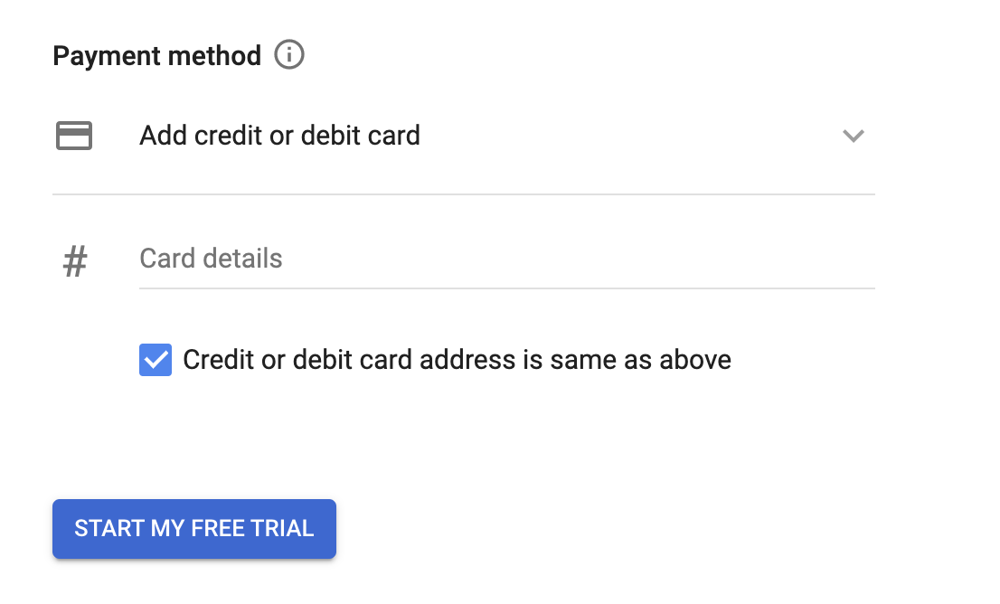
Billing Info for Credit Card

Slide 21
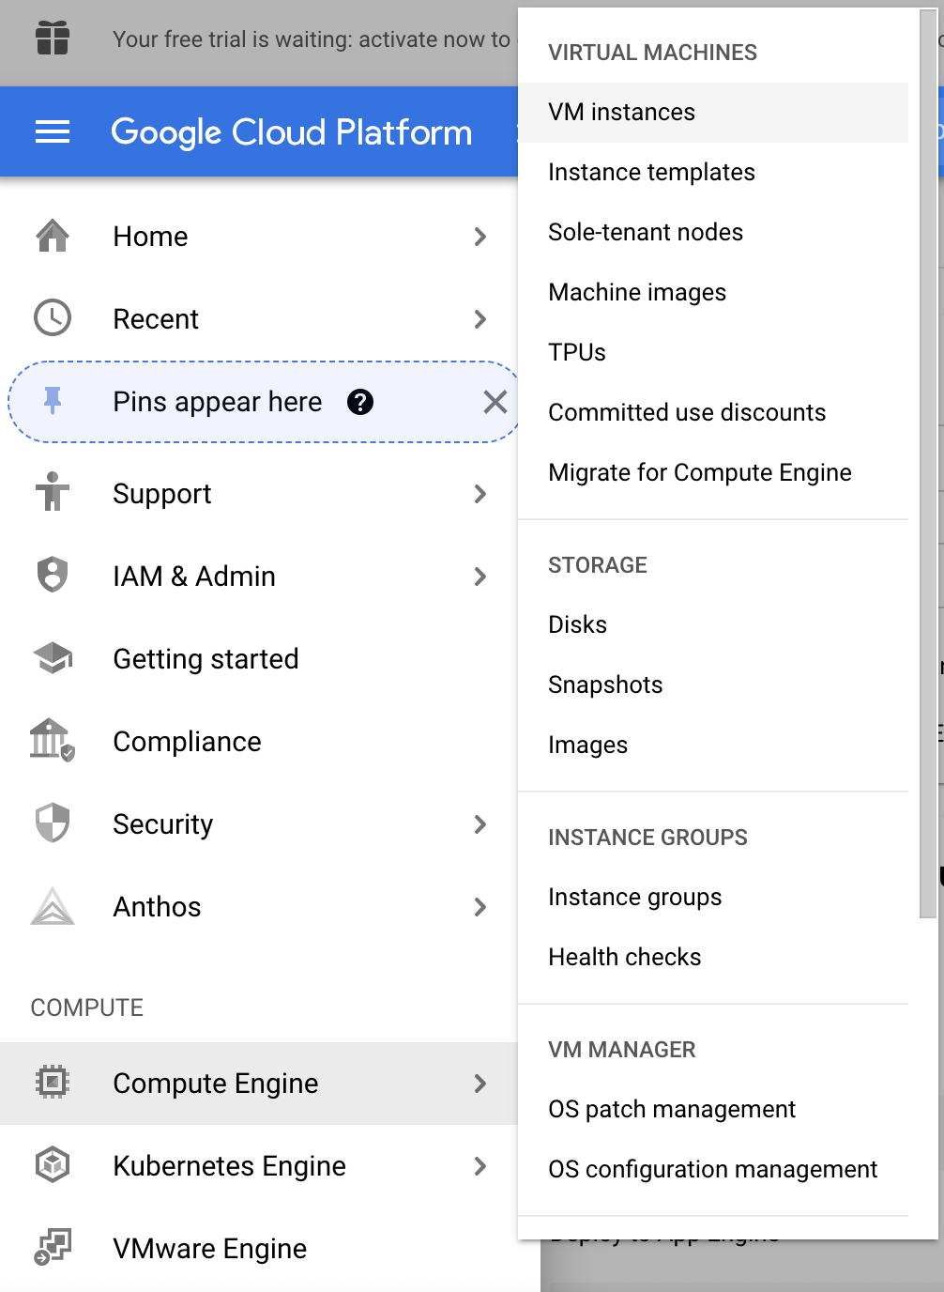
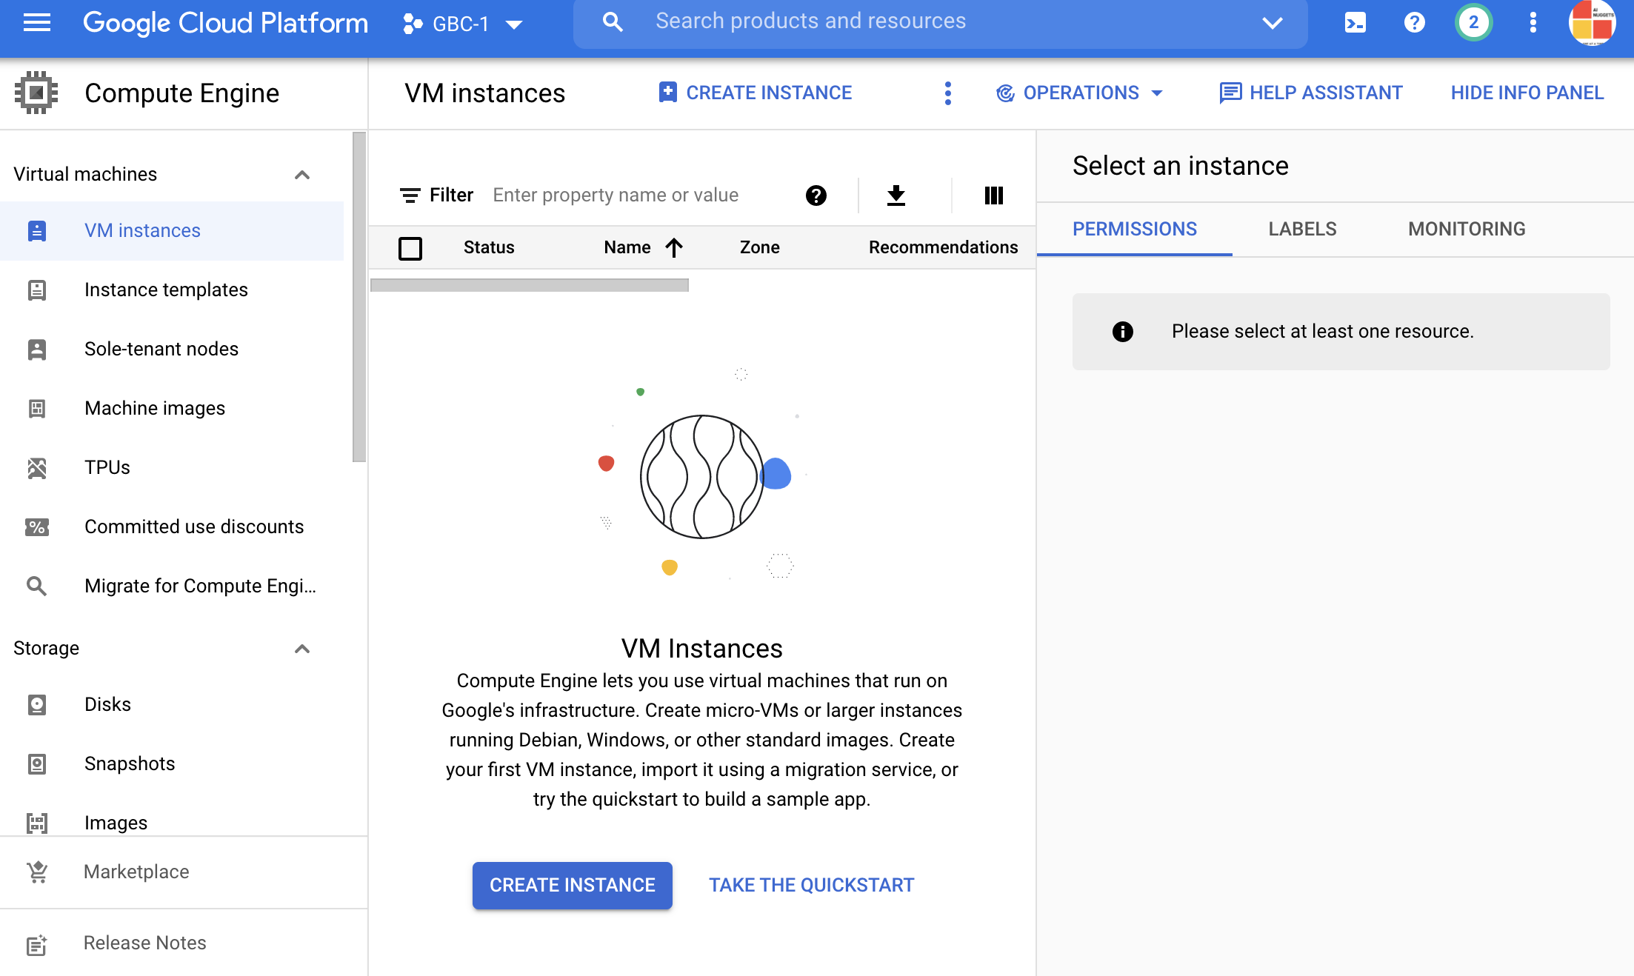
Create VM instance

Slide 22
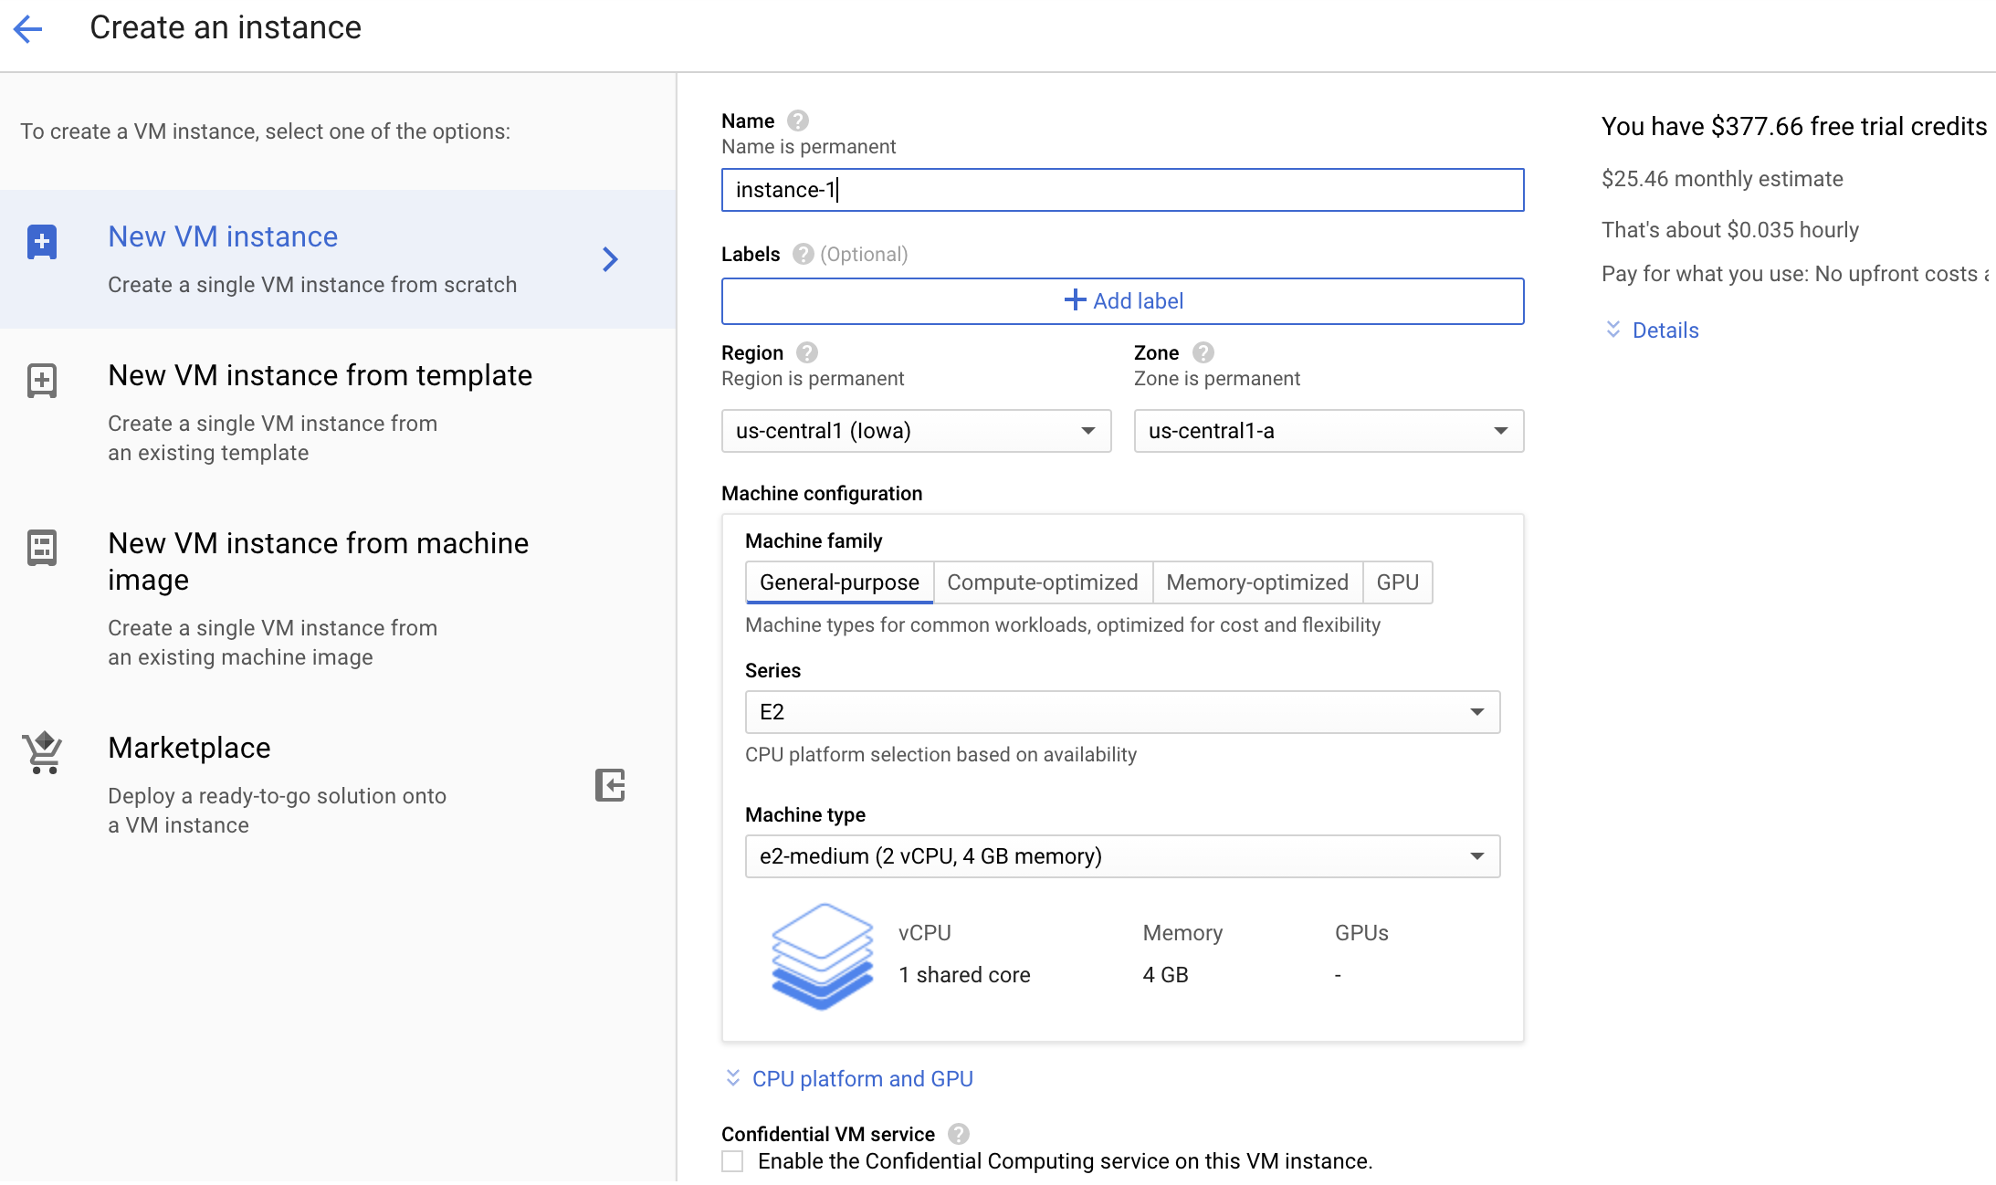
Create VM instance

Slide 23
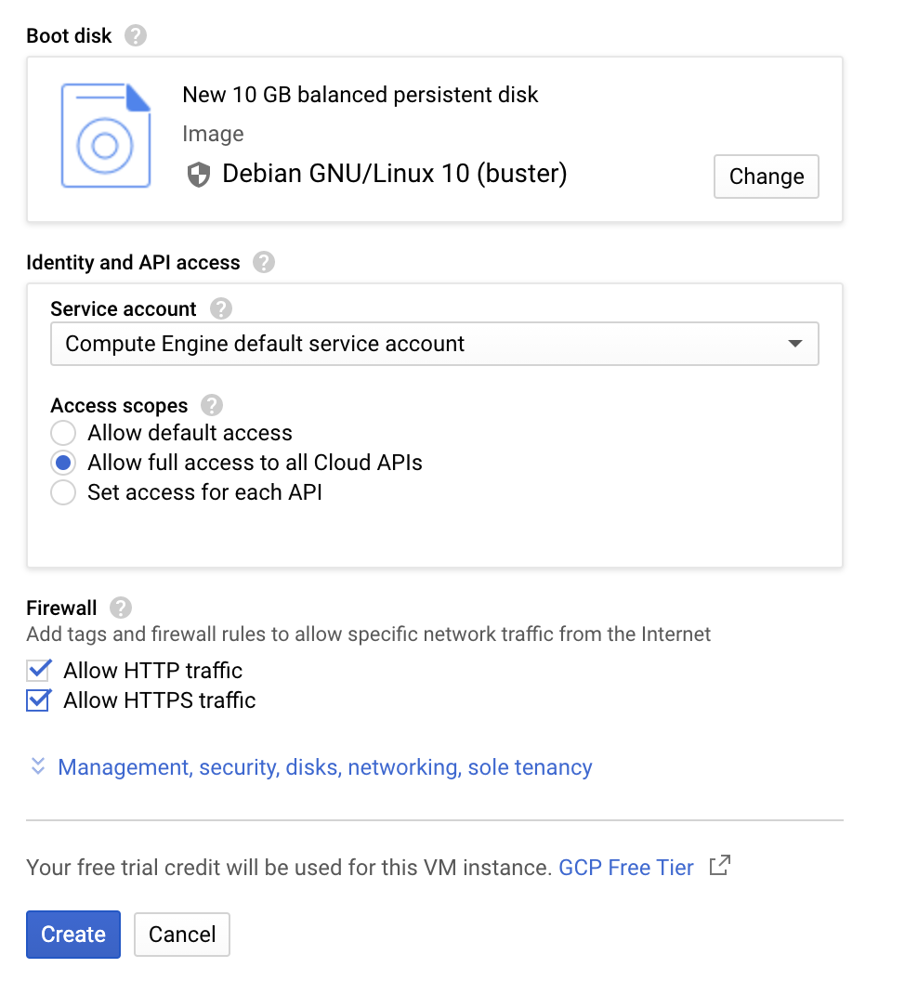
Create VM instance
Allow full access to all Cloud APIs
Allow HTTP traffic
Allow HTTPS traffic

Slide 24
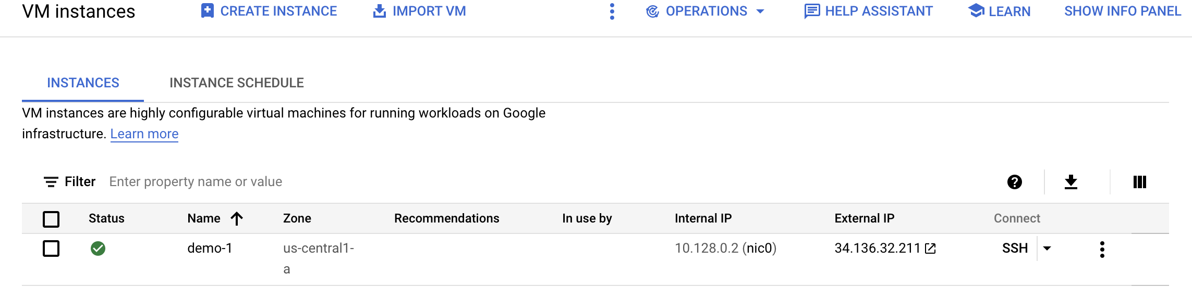
VM instance Created
34.136.32.211 [IP address]
Yours will be different

Slide 25
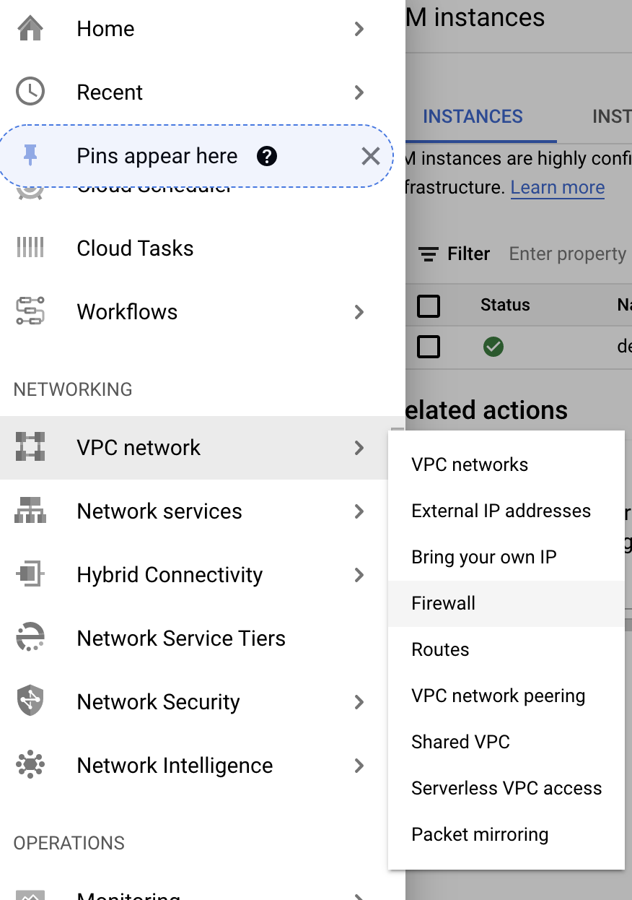
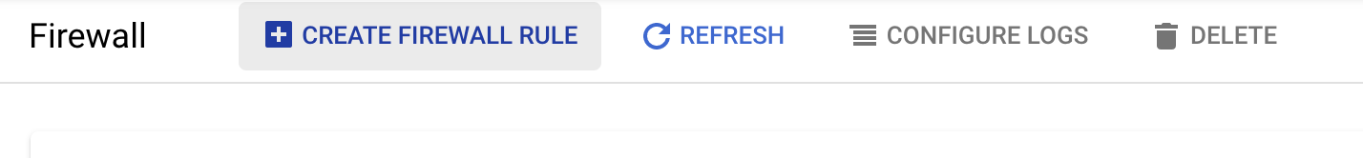
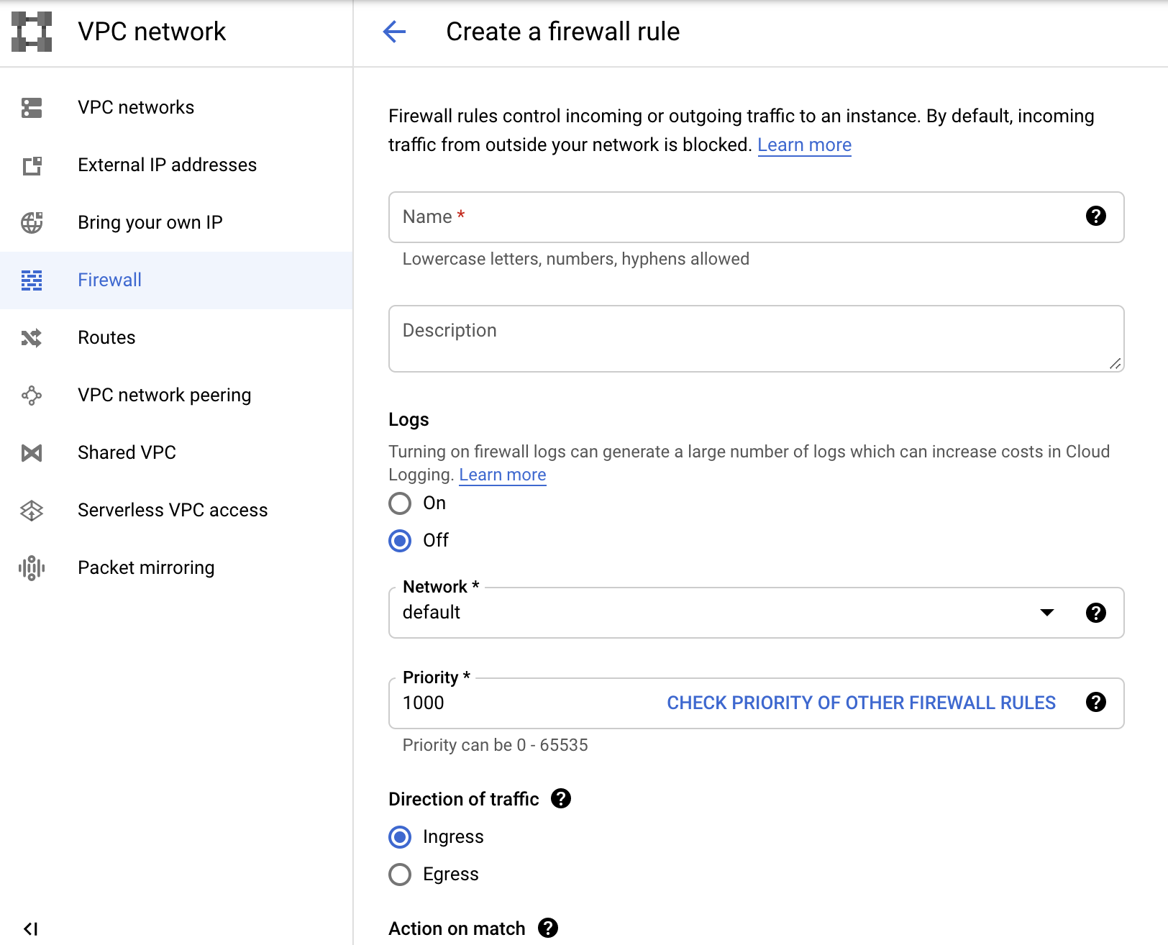
Create a Firewall rule

Slide 26
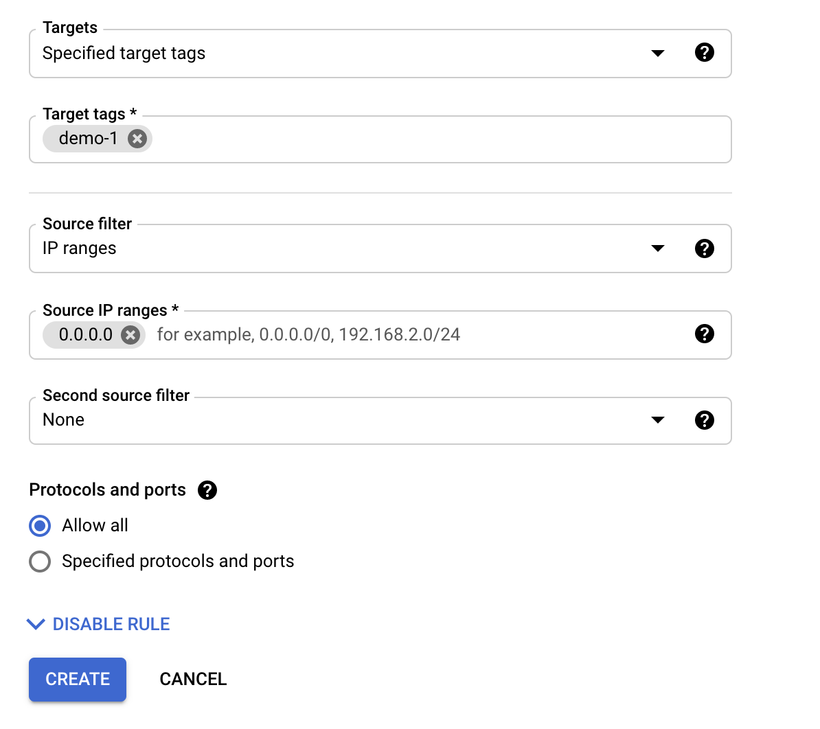
Create a Firewall rule
Target tags --> demo-1
Source IP ranges --> 0.0.0.0
0.0.0.0/0
Protocols --> Allow all

Slide 27
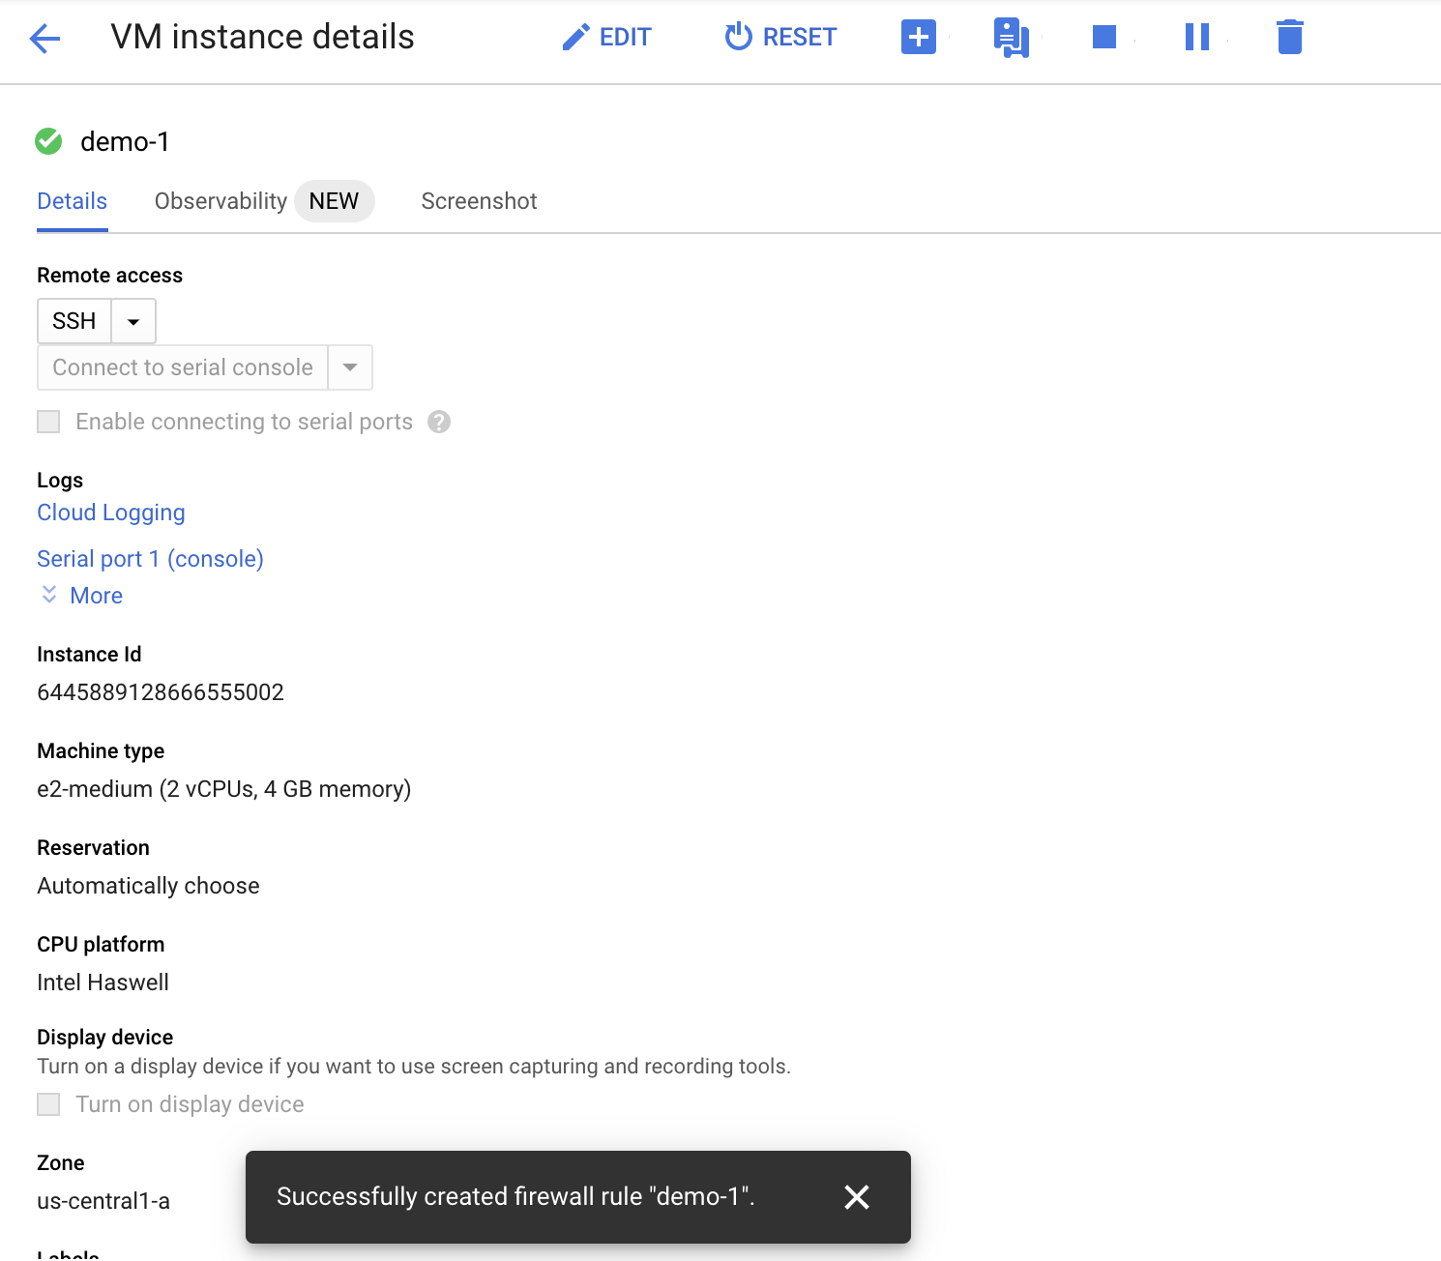
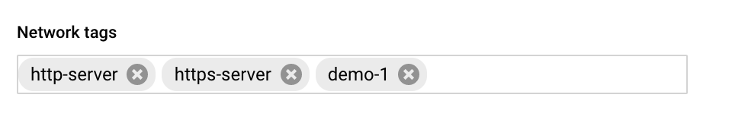
Edit VM instance
Network tags --> demo-1

Slide 28
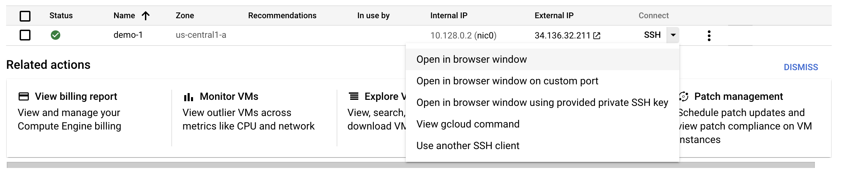
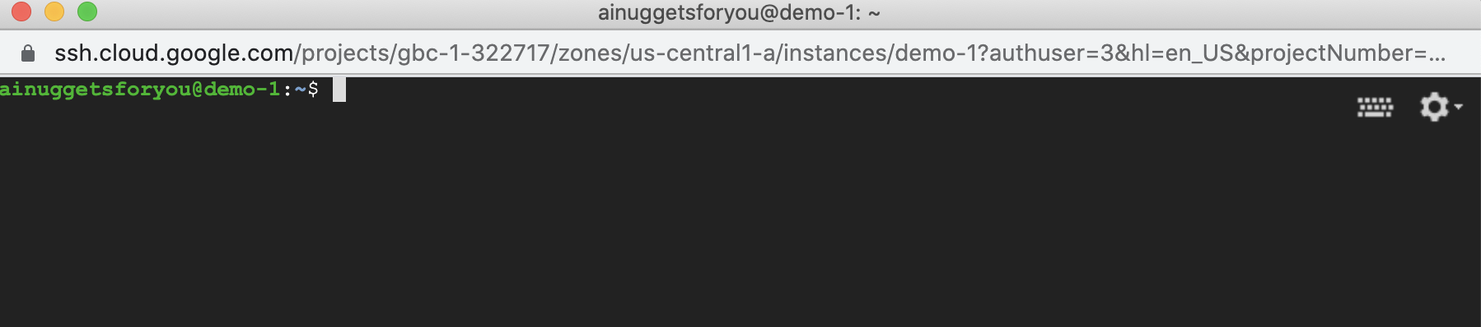
SSH

Slide 29
Installing Docker
sudo apt update
sudo apt install apt-transport-https ca-certificates curl gnupg2 software-properties-common
curl -fsSL https://download.docker.com/linux/debian/gpg | sudo apt-key add -
sudo add-apt-repository "deb [arch=amd64] https://download.docker.com/linux/debian $(lsb_release -cs) stable"
sudo apt update
apt-cache policy docker-ce
sudo apt install docker-ce
sudo systemctl status docker

Slide 30
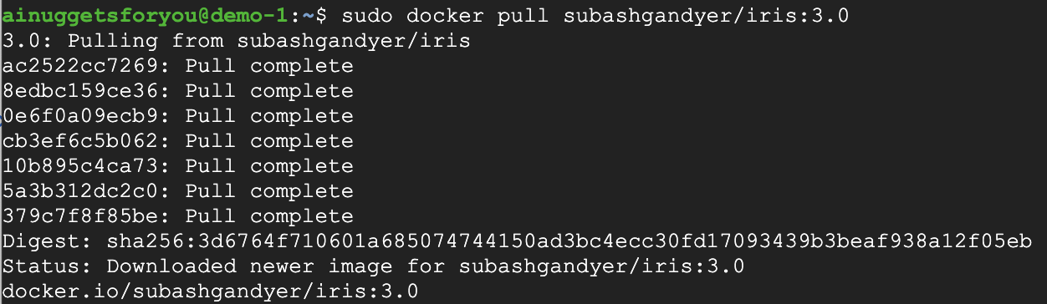
Pulling a docker image
Pulling a Docker image
sudo docker pull subashgandyer/iris:3.0

Slide 31
View docker image
Viewing Docker images in remote GCP machine
sudo docker images

Slide 32
Running a docker container
Running a Docker container inside GCP VM instance
sudo docker run -d --restart on-failure -p 5000:5000 subashgandyer/iris:3.0

Slide 33
View docker containers
Viewing Docker containers in remote GCP machine
sudo docker ps

Slide 34
Testing the docker container endpoints
Curl
POSTMAN
Python Web Client in browser

Slide 35
Curl Calls
curl http://34.136.32.211:5000/train
curl http://34.136.32.211:5000/
curl -X POST -d 'sepalLength=1.5&sepalWidth=3.5&petalLength=4.5&petalWidth=5.6' http://34.136.32.211:5000/final_classifier

Slide 36
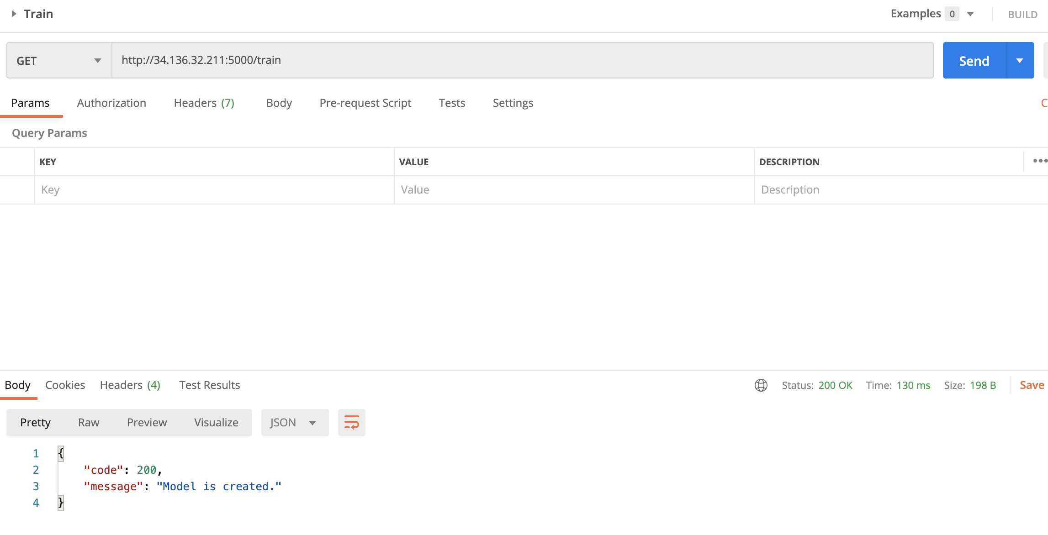
POSTMAN – train a model

Slide 37
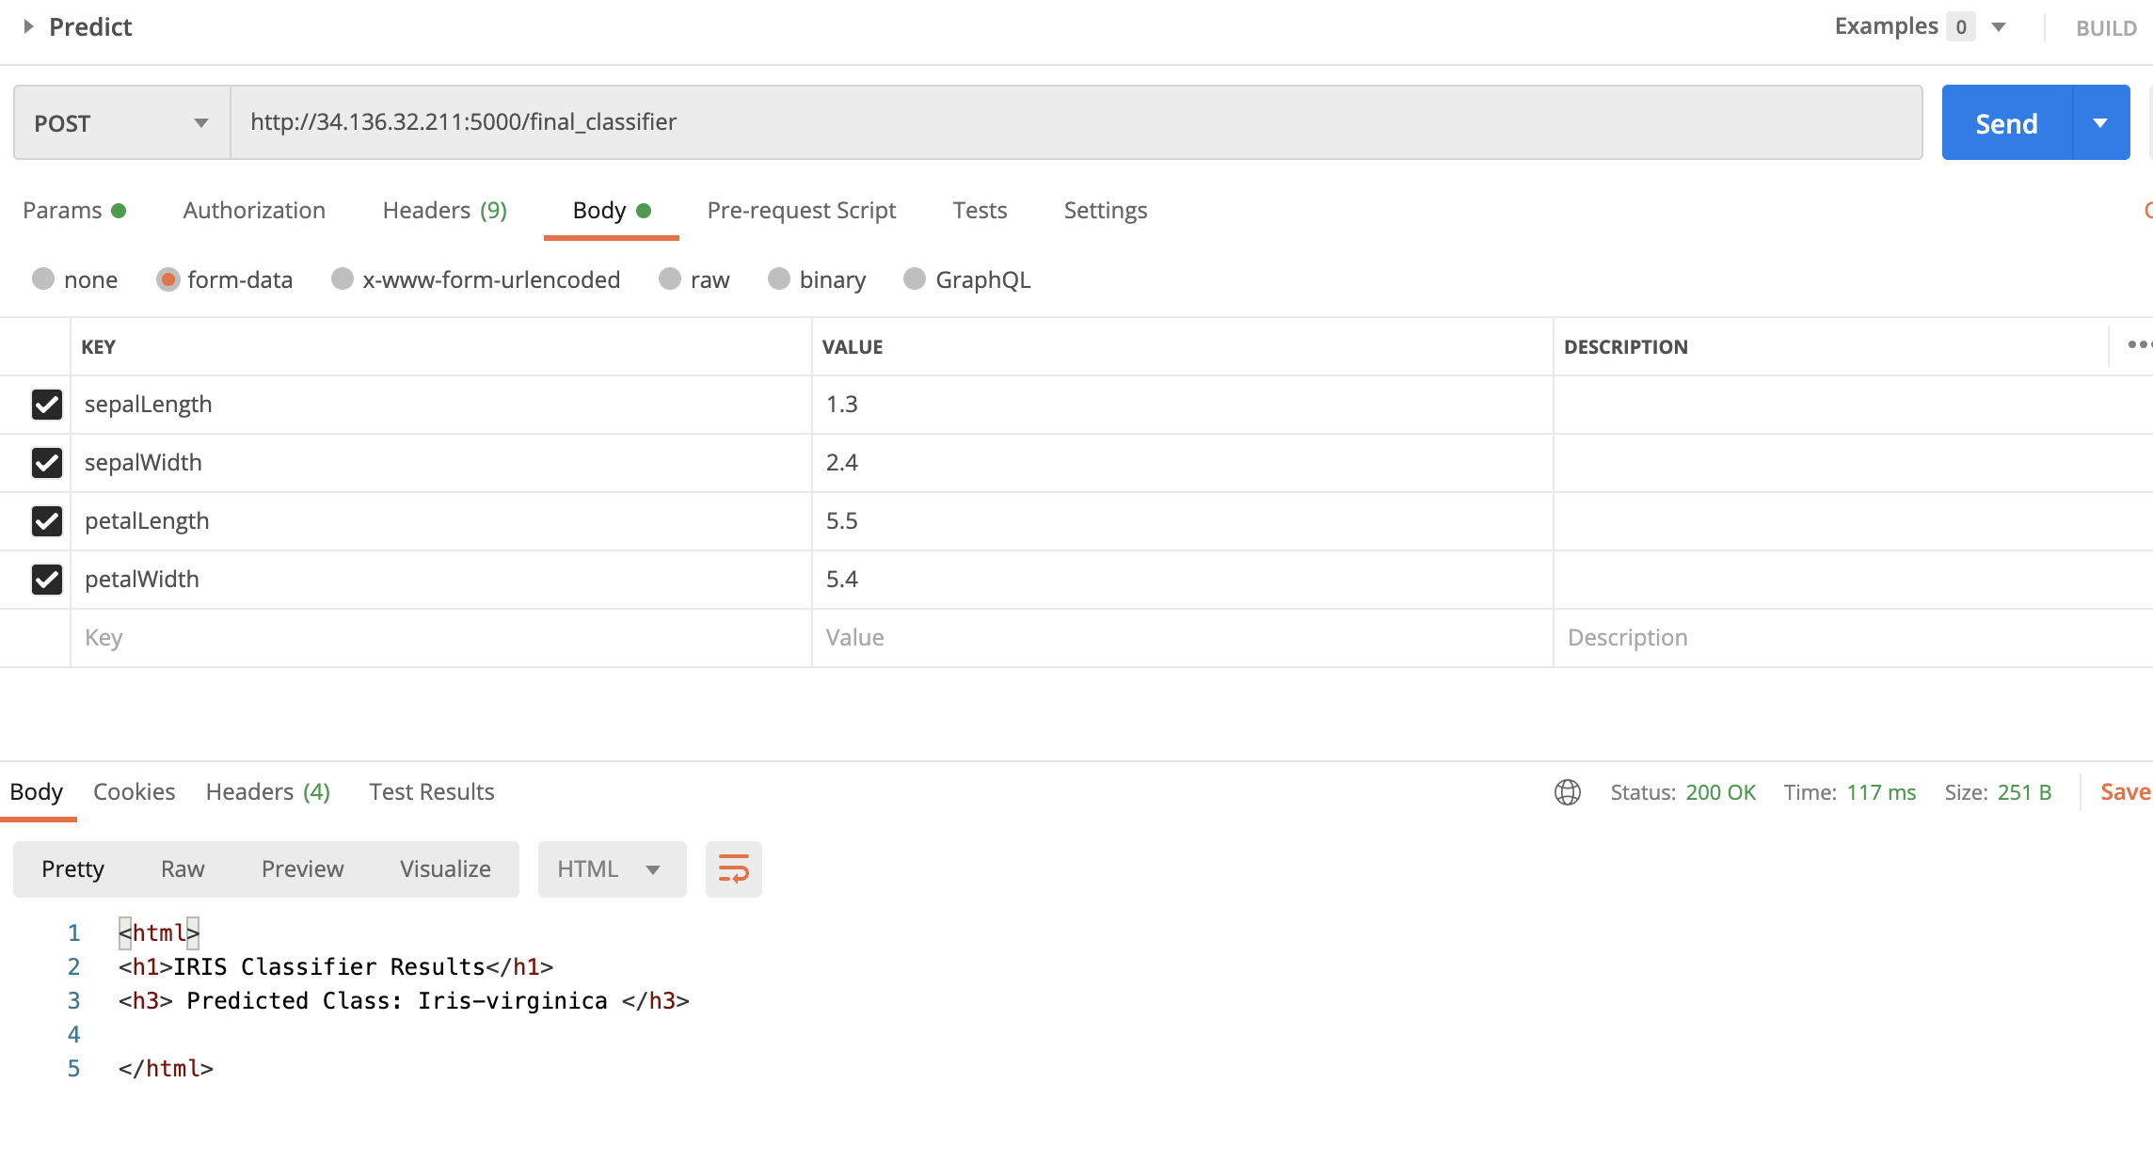
POSTMAN – classify a sample

Slide 38
Test with Python Web Client
Naviagate to
http://34.136.32.211:5000/train
Then,
http://34.136.32.211:5000/
Input the values within all fields
Click Classify button

Slide 39
Further Reading
Docker Tutorial
https://www.docker.com
Google Cloud Platform
https://cloud.google.com/docs

